Slide 1
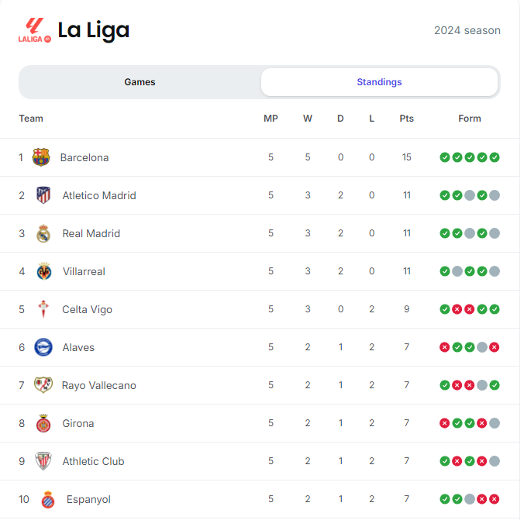
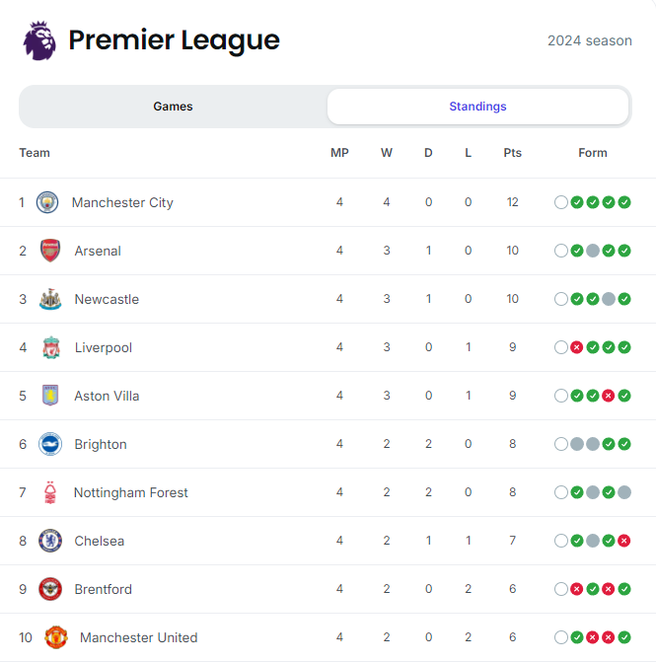
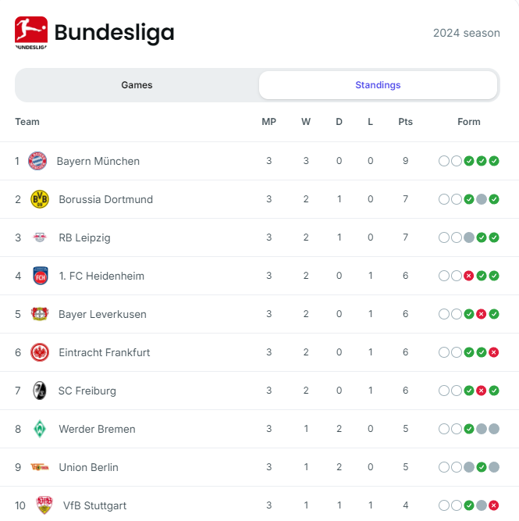
Leagues & highlights
https://www.youtube.com/watch?v=5EU_44XyZ1c
https://www.youtube.com/watch?v=-DWJIVIfWvc
https://www.youtube.com/watch?v=UsK62otRDQ0
https://www.youtube.com/watch?v=_LmaF2Ihrvg
https://www.youtube.com/watch?v=sSgamVx9Rl4&list=PLKj1QUtwqLN8QO098nP2MtOi2-upMU8tv
https://www.youtube.com/watch?v=X_An8DnUtfg
https://www.youtube.com/watch?v=KJ0gP4jM6y8

Slide 2

About us
About the website
Latest transfers:
Whats going in football

Slide 3

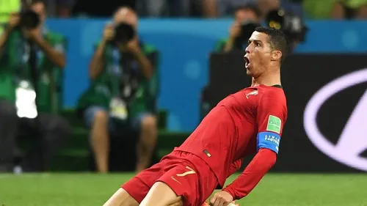
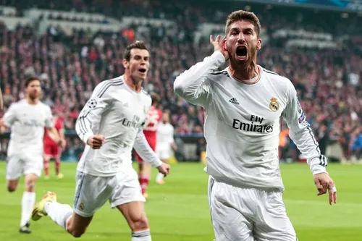

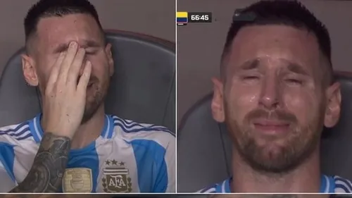


Gallery page

Slide 4
Services
The page where we only promote good stuff. https://www.lovellsoccer.co.uk/blog/post/the-5-best-football-boots-under-100-for-2024
The perfect site to purchase these wonderful boots. https://www.prodirectsport.com/soccer/l/adults/departments-boots/activity-football/
The only place to purchase your teams new shirt. https://www.kitbag.com/en/

Slide 5
Follow us on social media
Tiktok
Instagram
Snapchat
Twitter
Youtube

Slide 6
Contact us
Email
Number
Sign up to receive weekly updates of anything to do with football

